Slide 1
Vacancy Approval Process How to create a new request on
Talentlink
This is a guide on how to login into Talentlink, create a new vacancy request and how to initiate the approval process

Slide 2
Prior to submitting your vacancy approval request
Ensure you have the most recent job profile template completed ready for uploading on Talentlink
Please see the link to People Anytime for job profile templates Job Evaluation | Aberdeen City Council: People Anytime. If you are required to amend the content within an existing job profile, please notify Orgchangedesign@aberdeencity.gov.uk
Ensure you are aware of the cost centre and CoreHR post number. If you are unsure, please contact your Budget Holder or POD@aberdeencity.gov.uk who will be able to assist you
If your vacancy is currently being advertised on Talentlink or you have recently identified a preferred candidate(s) and you have now identified another vacancy, please complete a new request to recruit on Talentlink and select approval only in the Reason for Vacancy Field. Within the justification, please state that you wish to recruit from the existing ABC reference number so that we can match the new request to the previously approved request ie Identified additional preferred candidate from ABC11111

Slide 3
Prior to submitting your vacancy approval request
If you wish to recruit to various posts ie a mixture of full time and part time, please submit two separate requests.
For example –
1 x 10 hours Permanent
1 x 37 hours Permanent
1 x 20 hours Fixed Term
1 x 37 hours Fixed Term
This would be submitted as two requests with all the full time posts (Fixed Term and Permanent) in one request and the part time posts (Fixed Term and Permanent) in a separate request

Slide 4
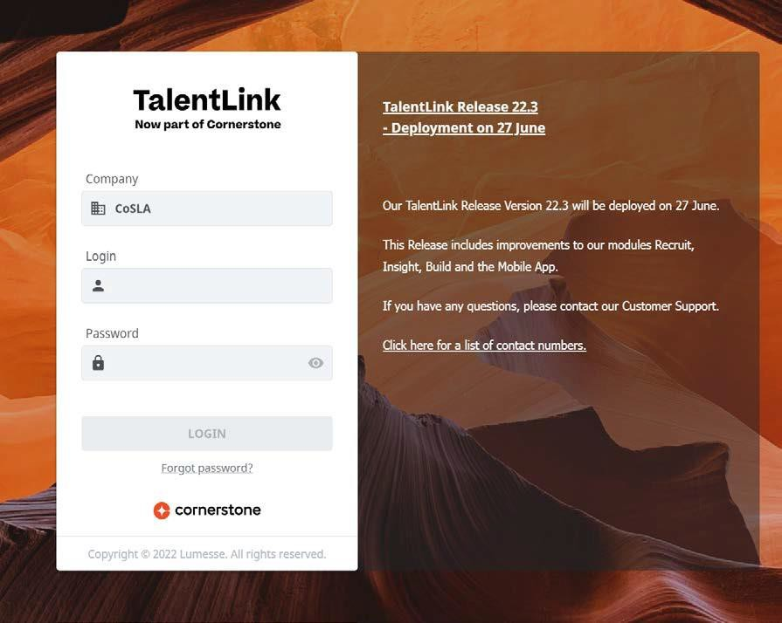
Login Screen
Enter the link for Talentlink in a web browser – https://emea5.lumessetalentlink.com/?sso_id=ACCTalentlink
Enter CoSLA in the Company
Field
Please note, this is case sensitive
You will have received your username and password from AskHR

Slide 5
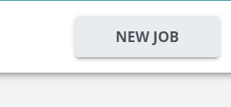
Create New Job for Recruitment
Once you have logged in, you will see the home screen dashboard
To allow you to create a new job for recruitment, click on the New Job button in the top right hand corner

Slide 6
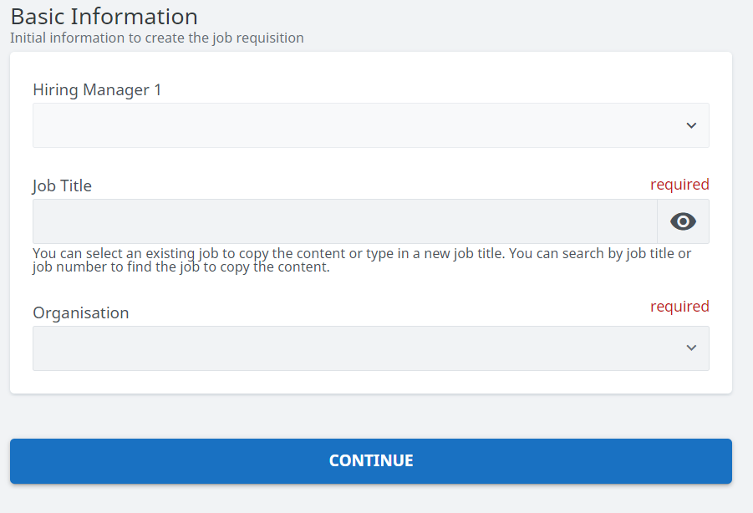
Job Information
On the Basic Information page, please enter the name of the person submitting the vacancy request as Hiring Manager 1 and the Job Title of the role you are requesting to fill

Slide 7
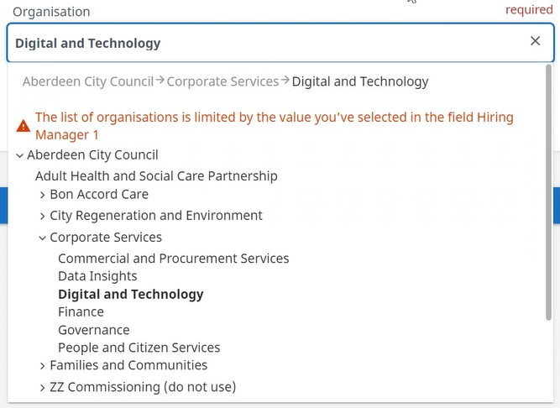
Job Information Continued
To select the relevant Cluster for the role you are looking to recruit to, click on the drop down arrow, then click on the arrow beside Aberdeen City Council, select the drop down arrow under the relevant Function and then click on the relevant Cluster
Please do not use the options with ZZ in front of them

Slide 8
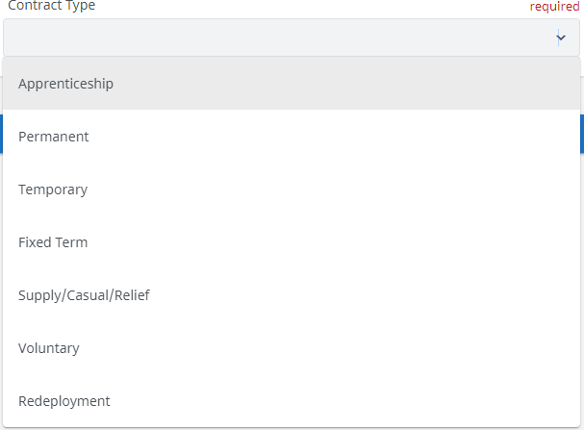
Contract Type
After selecting from the Organisation drop down, select the Contract Type
Please select the relevant option
If you require Permanent and Fixed Term, please select Permanent and in the comments box further down the page, you can state Permanent and Fixed Term
Please note once selected, you cannot change this option later

Slide 9
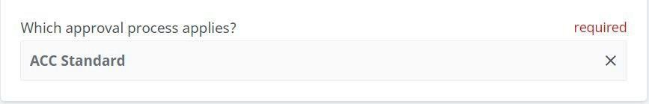
Approval Process
The next box will ask you 'Which approval process applies?', please leave this defaulted as ACC Standard

Slide 10
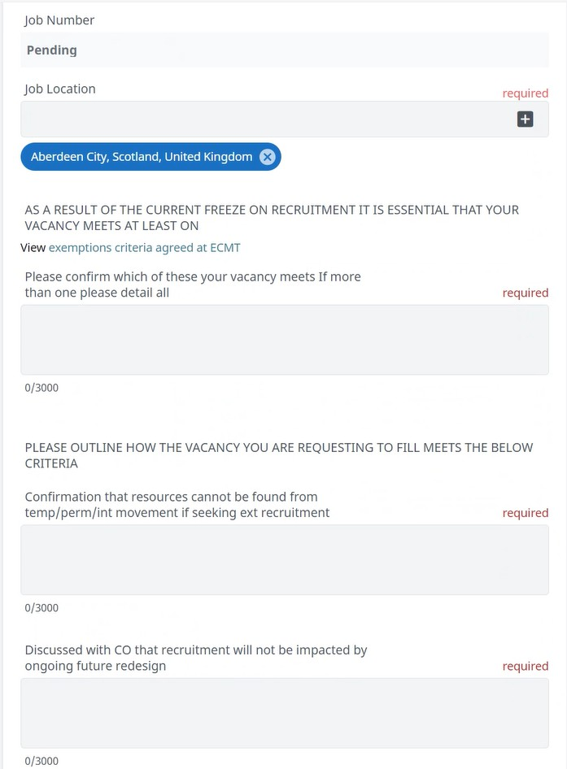
Job Details
On the Administrative Data section, please proceed to complete the relevant fields
Please ensure you add in as much details as possible
Once you submit
your request to recruit,
the Job Number section will generate your ABC reference number for all future correspondence related to your vacancy

Slide 11
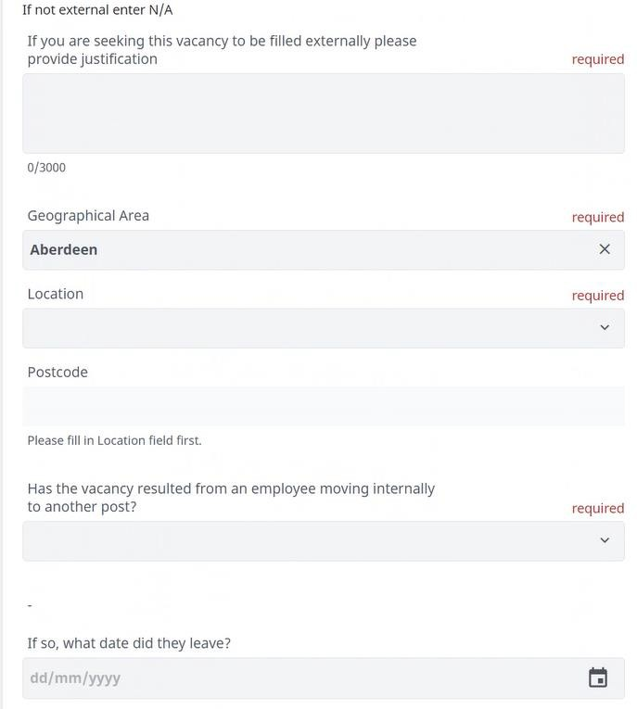
Job Details Continued
Please proceed to complete the relevant fields
When you reach the Location drop down, the Postcode field will auto populate
If your vacancy has resulted from an employee moving internally, please confirm the date they left the vacancy you wish to recruit to

Slide 12
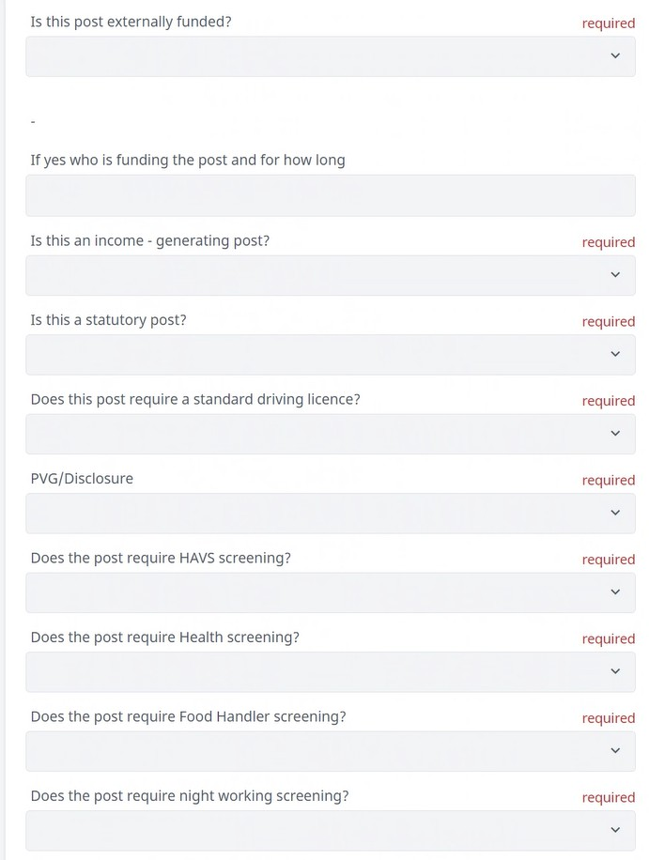
Job Details Continued
Please complete the drop down fields to allow the HR Service Centre to undertake the required pre- employment checks for your preferred candidate (s)

Slide 13
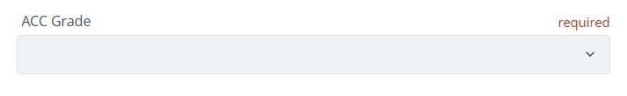
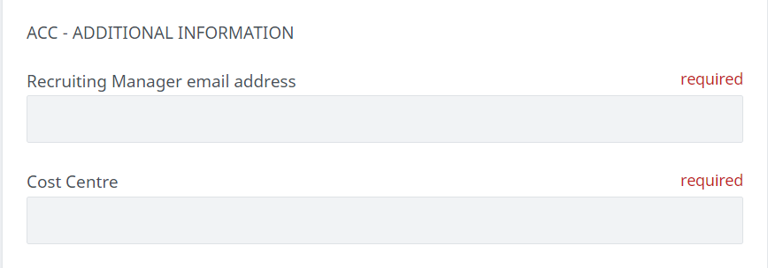
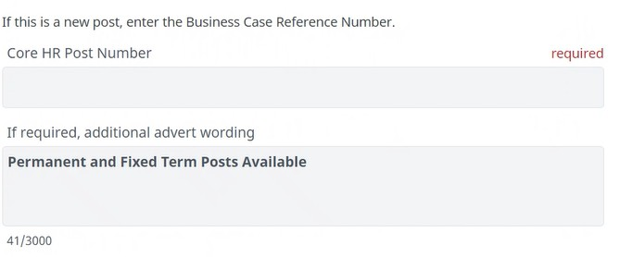
Job Details Continued
Select the relevant ACC Grade e.g. G9
For Recruiting Manager email address – please enter the details of the individual who the HR Service Centre will correspond with during the pre- employment checks
For Core HR Post Number – please add in the post number or enter the Business Case Reference Number if it is a new post. Your budget holder
or POD@aberdeencity.gov.uk will
be able to confirm this if you are unsure
If you have additional advert wording, please input the relevant wording and it will pull through to your advert. In this section, you would state that you are recruiting to Permanent and Fixed Term posts.

Slide 14
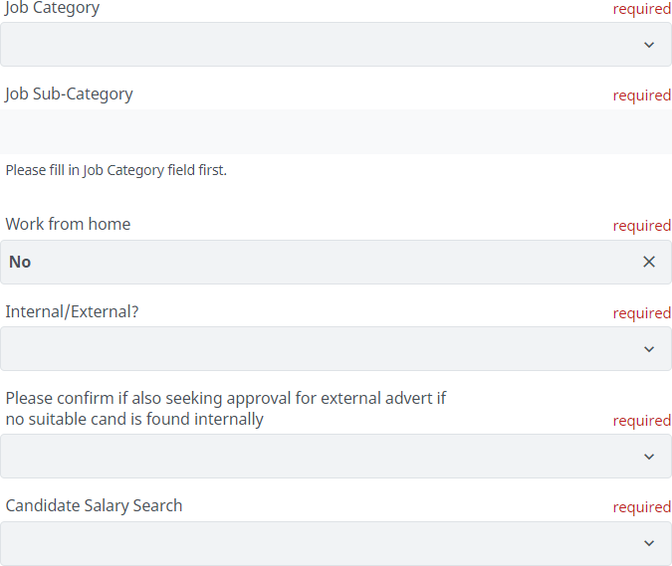
Job Details Continued
Please use the guidance provided to identify the relevant Job Category and Sub-Category
Select if the post can Work from Home
If External is selected, then the post will be advertised Internally AND Externally
If Internal is selected, the post will be advertised Internally only
If you are seeking approval for external advertising if no suitable candidates can be found through initial internal recruitment only, please select Yes or No under the relevant field
For the Candidate Salary Search, select the salary banding which applies

Slide 15
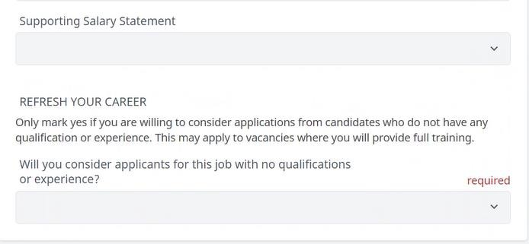
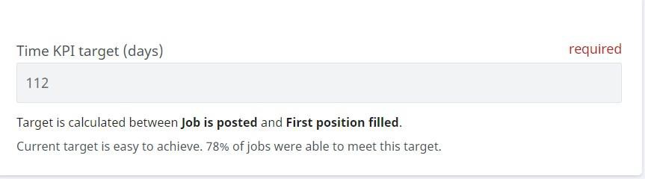
Job Details Continued
For Supporting Salary Statement, please leave this blank
For the Refresh Your Career option, please select No if there are any qualification requirements on the job profile
Please do not amend the
Time KPI target (days)

Slide 16
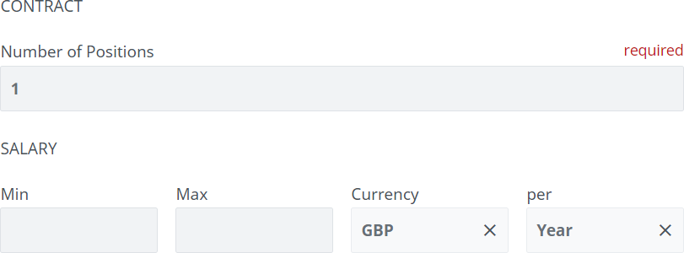
Contract Information
For the Number of Positions please input the number of individuals you wish to recruit e.g. if you have 1.5FTE (3 x 0.5FTE) please enter 3 in this field rather than 1.5
Salary ranges can be found on People Anytime Salary Information
| Aberdeen City Council: People Anytime or Appendix 2.1 - SNCT Handbook for Teaching Staff. The ranges can be added in the Salary section of the form, under Min and Max. For part time and full time 52 week posts, please input the annual salary. For part year worker posts ie 39 weeks, please input the hourly rates and change the per section to state hour.

Slide 17
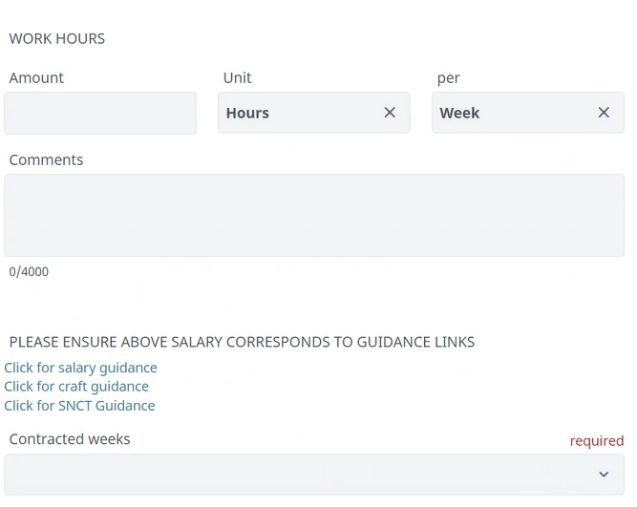
Contract Information
If you have more than one vacancy with various hours eg 15 and 25 per week, input the highest number of hours against the Work Hours
Please leave the Comments
section blank
The salary links will assist you with completing the salary section
Select the relevant Contracted Weeks ie 39 for school based staff who only work term time/41 weeks for cleaning staff. If you have more than one vacancy with various contracted weeks, input the highest number of weeks eg 52
On the next slide you will be able to confirm the vacancy details for multiple posts

Slide 18
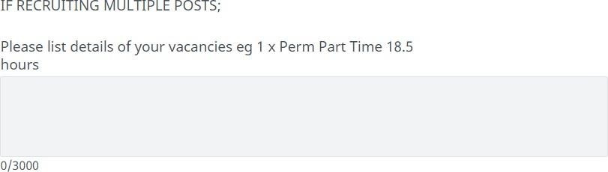
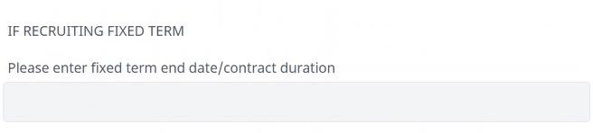
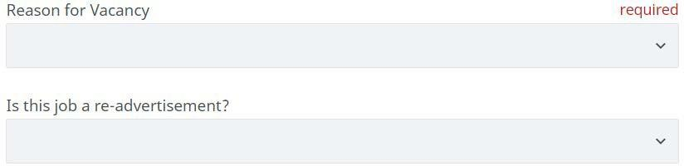
Contract Information
Under the section IF RECRUITING MULTIPLE POSTS, you will be required to list the differences between any contracts you are looking to recruit to.
For example:
1 x fixed term up to 31/12/2025 full time
1 x fixed term up to 30/06/2025
full time
1 x permanent full time

Slide 19
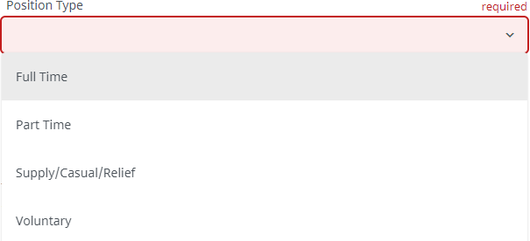
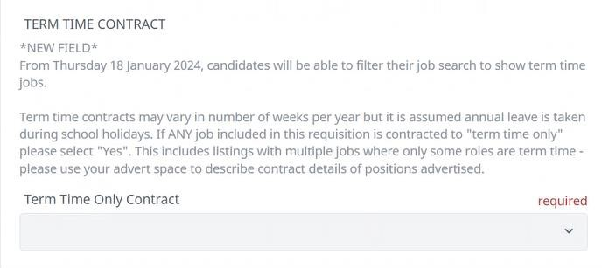
Position Type
After advising if the vacancy is advertisement, you will option for Position Type
a re-see an
Please select the position type which applies to your vacancy
Please note Job Share should only be selected for Teaching posts
If the post is a Term Time Only Contract, select Yes otherwise select No

Slide 20
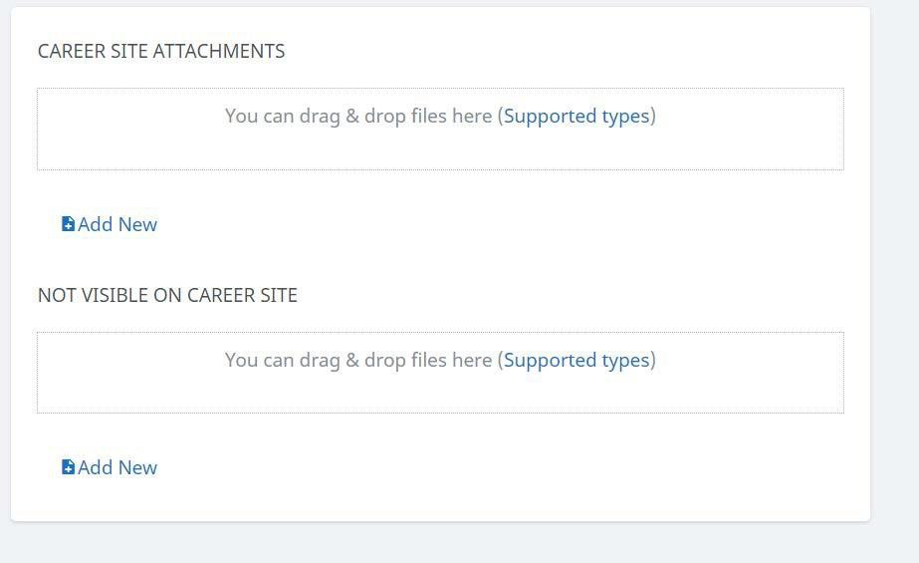
Attaching the Job Profile
Under the Career Site Attachments, you will be able to attach the job profile for this role
Please ensure you have the most up to date template
If you are required to amend the content within an existing job profile, please
notify Orgchangedesign@aberdeencity.gov.uk
Please do not attach anything on the Not Visible on Career Site

Slide 21
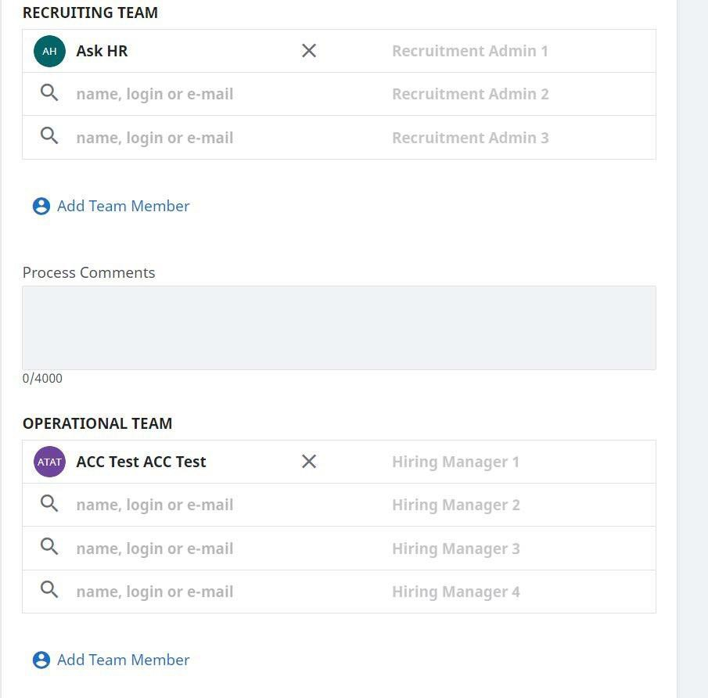
Selecting the Recruiting Team
Recruiting Team is ALWAYS
AskHR for Recruitment Admin 1, as AskHR will
publish the
vacancy once it has obtained all the required approvals. If AskHR is removed, they will also not be
notified once the approval process has been completed or details of your preferred candidate(s). If you do not input AskHR, your vacancy will not be advertised and AskHR will be unable to undertake pre-employment checks
Operational Team (Recruitment Panel) is the names of the individuals you would like to have access to the vacancy (e.g. anyone who would have access to view the number of applicants once the vacancy is
published or anyone who would sit on the interview panel)

Slide 22
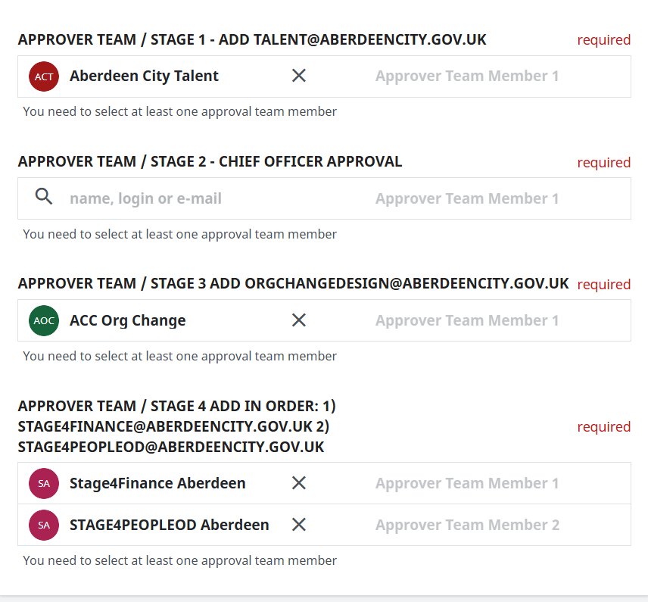
Commencing the Approval Process
Prior to your request being advertised, the request requires to go through four stages of approval. Please
type in the email addresses as shown in the image to the left:
Stage 1 – Talent Team. The team will review the request to check that all sections of the request is correct (e.g. job profile attached, if the advert will be internal or external)
Stage 2 – Chief Officer. Once approved by the Talent Team, the request will be sent to the relevant Chief Officer for approval. Please check with your Chief Officer or Service Manager prior to submitting to ensure the Chief Officer is available to approve your request
Stage 3 – Org Change Design. The request will then be sent to the team to check the establishment to see if the vacant position is available to be recruited to
Stage 4 – Chief Officer of Finance and People & Citizen Services. The Chief Officers will complete the final approvals to allow your request to proceed

Slide 23
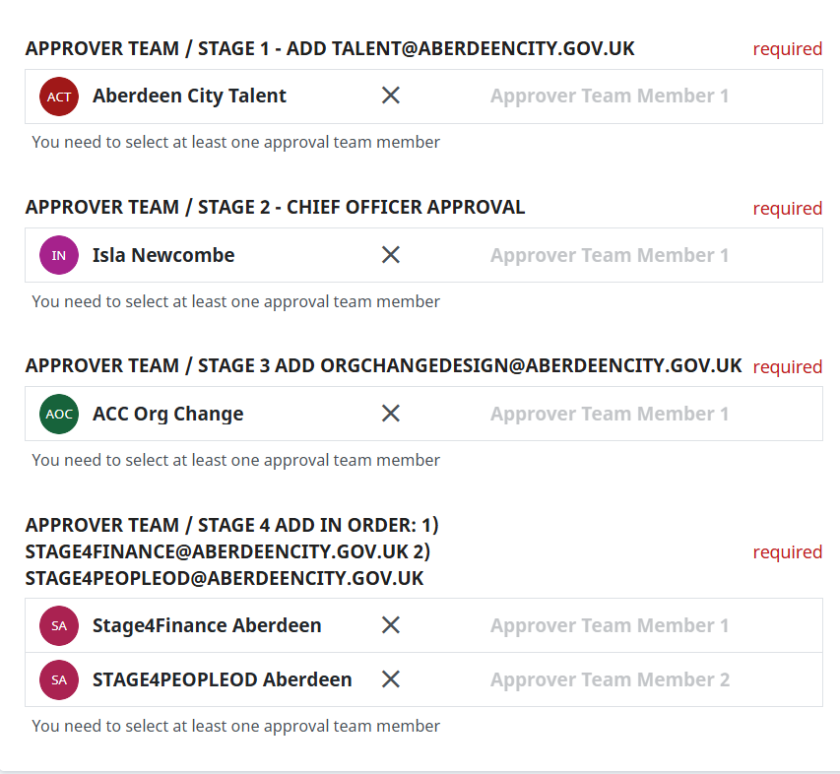
Commencing the Approval Process Continued
To commence the approval process please enter the email addresses advised in the relevant sections.
Stages 1, 3 and 4 should
ALWAYS remain the same. It would only be Stage 2 which would differ based on your Chief Officer

Slide 24
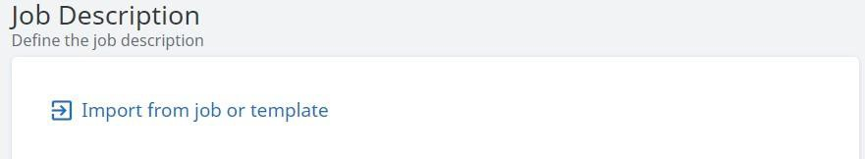
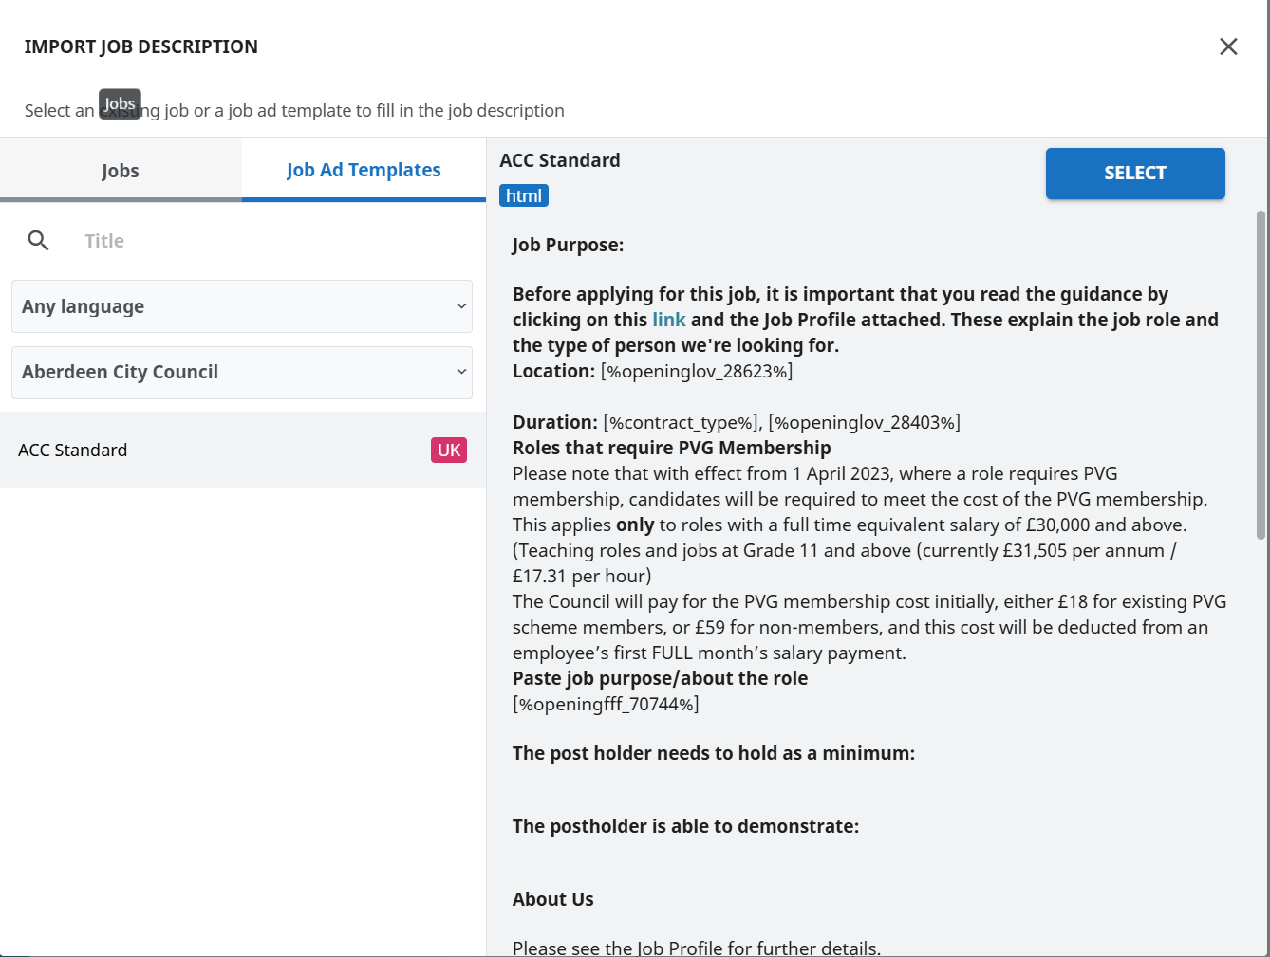
Attaching the Job Templates
Under Job Description, you will need to enter information from your job profile which will be used on
the MyJobScotland website
Once you click on Import from job or template, you will guided to the page on the left
Click on Job Ad Templates and click on ACC Standard and then on Select

Slide 25
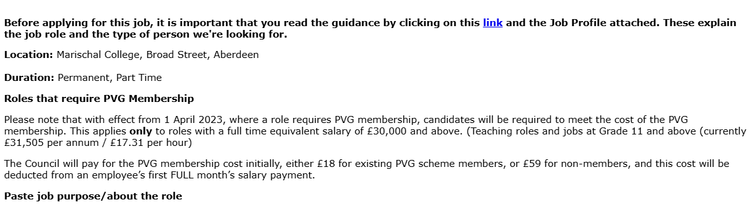
Inputting Job Purpose Information
Location and Duration will be auto generated based on information previously input
Please leave the PVG Membership information in even if your post does not require a PVG. This is standard for all adverts
For the job purpose/about the role please copy and paste from your job profile as it provides specific information confirming the purpose of the post
If you completed the additional advert wording field, the information will pull through. Within this section, it would confirm to candidates that there are Permanent and Fixed Term posts available

Slide 26
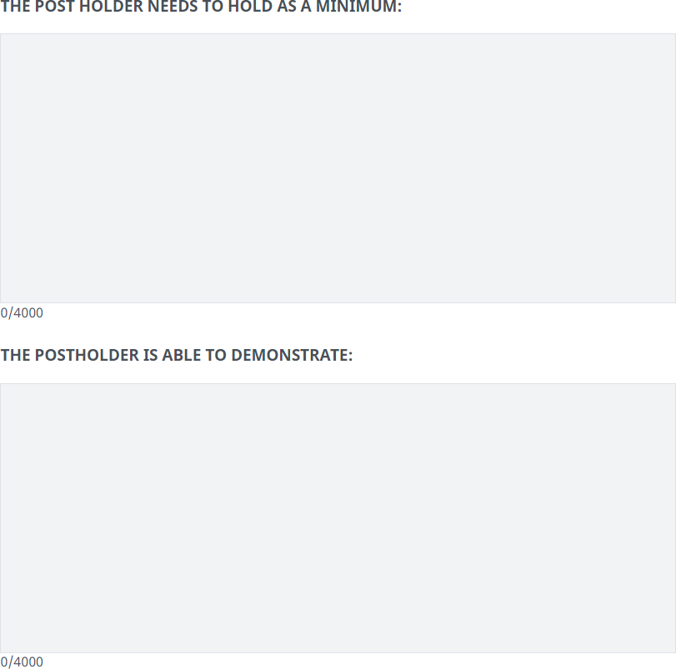
Inputting Job Purpose Information Continued
The Post Holder Need to Hold as a Minimum should be copied and pasted from the "Minimum Qualification(s) / Certificates / Memberships etc. Required" section on the Job Profile
The Postholder is Able to Demonstrate should be copied and pasted from the "As a minimum, demonstrate skills and experience in" section on the Job Profile

Slide 27
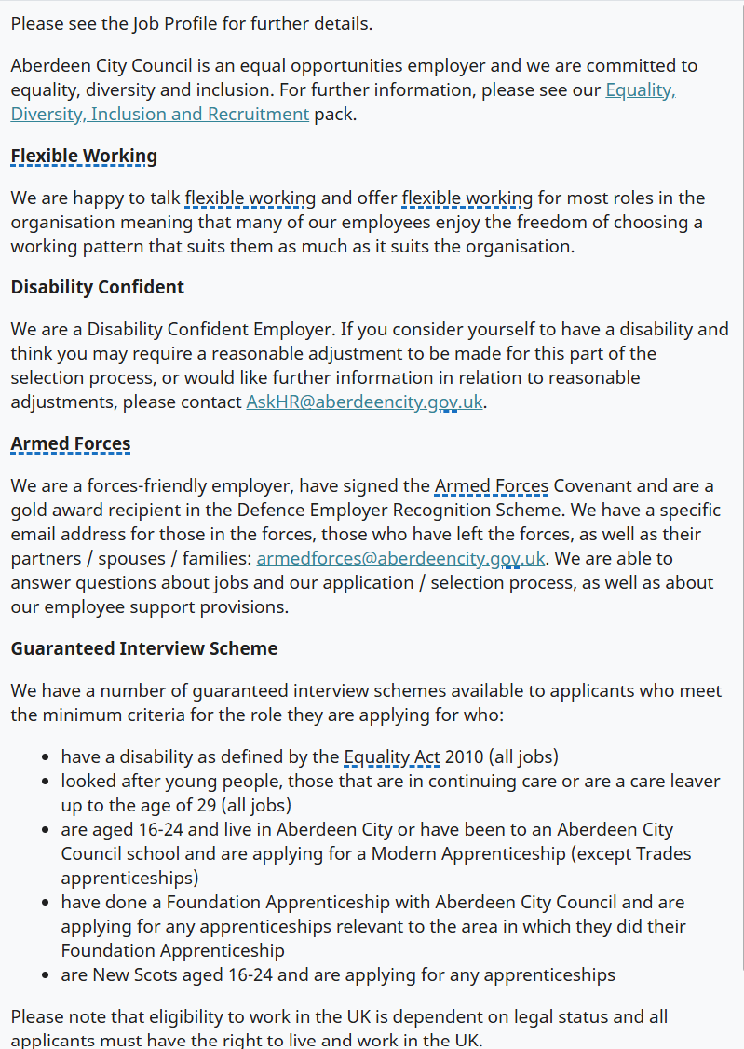
About Us Information
The section on the left is standard information advertised on all Aberdeen City Council
vacancies. Please do not edit this
section

Slide 28
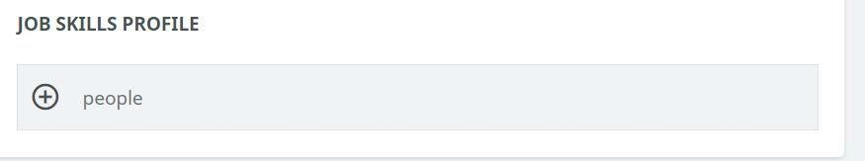

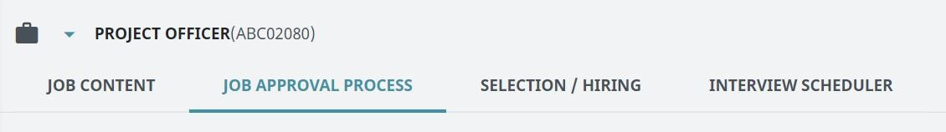
Finalising the Vacancy Approval Requests
Please leave the Job Skills Profile
section blank
Once you have completed the previous steps, click on Create in order to process your request to recruit. At this point your ABC reference number will populate

Slide 29
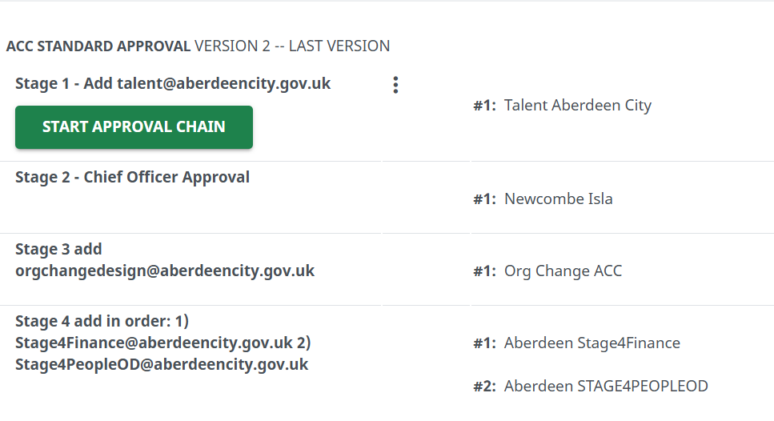
Commencing the Approval Process
On the next screen, you will see the Job Approval Process
Click on Start Approval Chain to begin the approval process. It is important you click the button as the request will not proceed if not selected

Slide 30
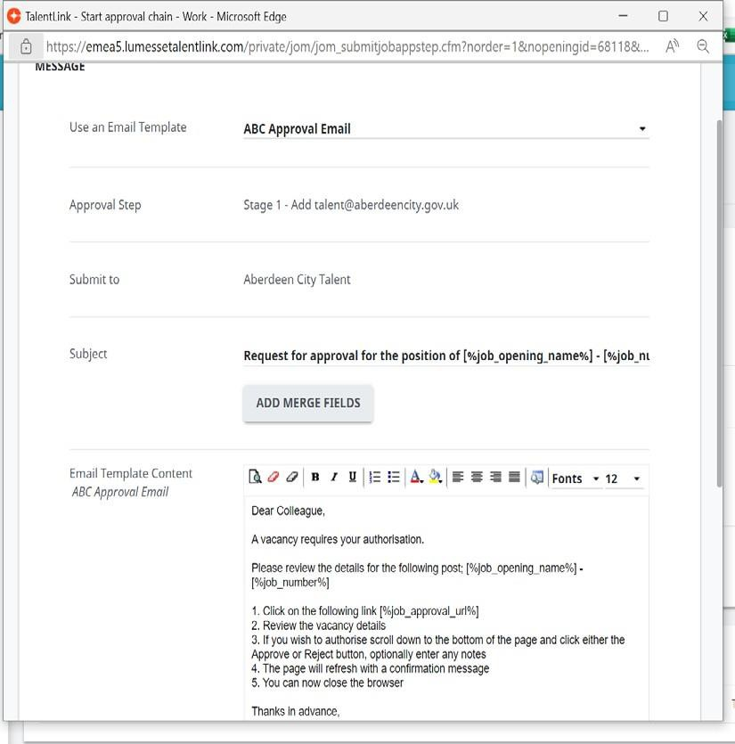
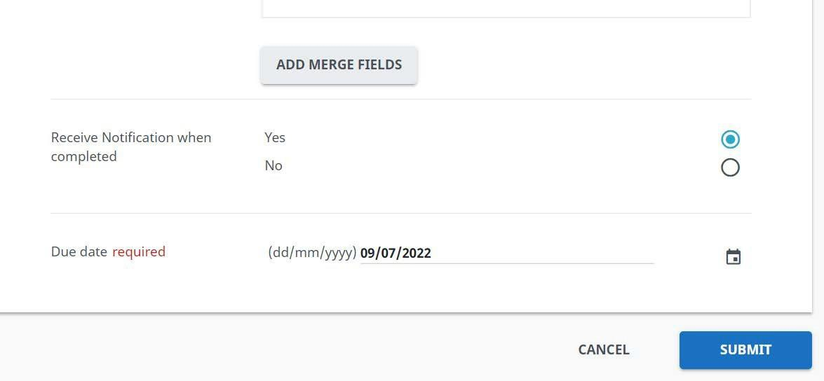
Commencing the Approval Process Continued
Next, you will be taken to the page shown on the left. You will be able to view the approval email being sent
Please do not edit the page. Please proceed
to scroll down the page and click Submit in order to send your request to recruit to the
Talent Team to commence the approval process

Slide 31
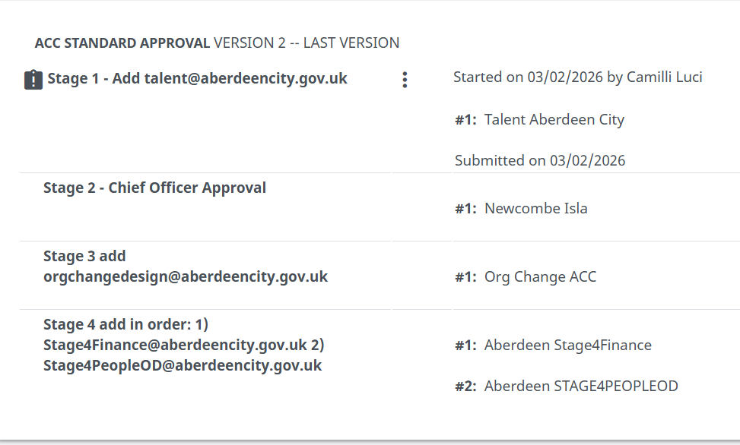
Vacancy Approval Process
Under the Job Approval Tab, you will be able to see where your request is in the approval process
On the left, you will see an example of a request sitting with the Talent Team as part of Stage 1 of the approval process
At each stage of the approval process, the approvers email address will receive an automated email in which the individual can approve or reject. Comments can also be added to the vacancy request

Slide 32
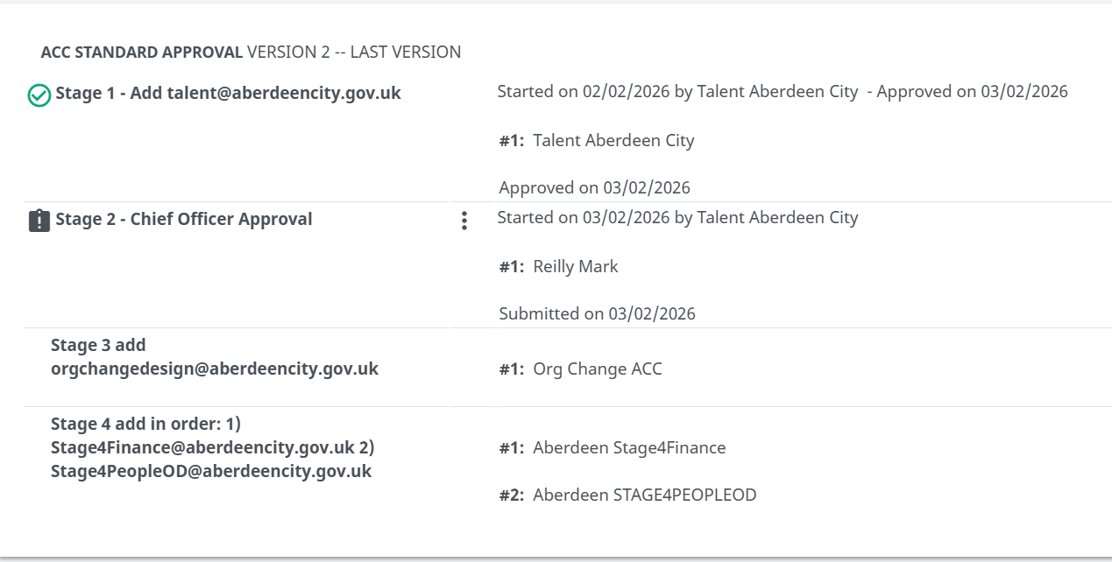
Vacancy Approval Process Continued
On the left, you will see an example of a vacancy request which has now been approved. It will also show when the request was approved at each of the stages
In this example, you will see the request has moved to Stage 2

Slide 33
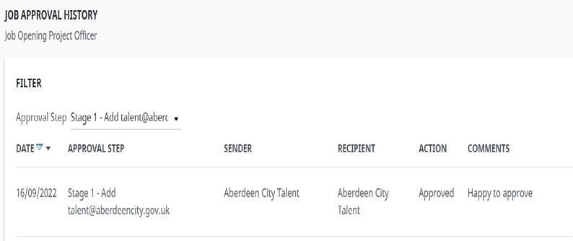
Vacancy Approval Process Continued
If you click on View History
within the Job Approval Process you are able to view
any comments as seen in the example on the left
Talentlink will automatically chase the approvers in each stage of the process
Once your vacancy has been approved by all 4 stages, AskHR will receive a notification to advertise the vacancy if you have selected Recruitment Admin 1 as AskHR

