Slide 1
The Leadership Forum
Build Back Better
Reinstatement of Services
Thanks for joining!
Starts at 1pm

Slide 2
The Leadership Forum
Build Back Better
Reinstatement of Services

Slide 3
Today: Reinstatement of Services
Stephen Booth, Chief Officer – Corporate Landlord
Vikki Cuthbert, Assurance Manager
Isla Newcombe, Chief Officer – Organisational Development
Martin Murchie, Duty Emergency Response Co-Ordinator

Slide 4
Today: Reinstatement of Services
It is important that now we begin to prepare for the reinstatement of some services within ACC so that as lockdown measures are relaxed we are in a position to reopen services in a way which is safe for both staff and the citizens of Aberdeen.

Slide 5
Introduction
What is the situation right now?

Slide 6
Why have a Process?
Consider the safety of staff and customers when re-introducing services.
Consider the Wellbeing issues with staff around service delivery.
Making sure necessary building and workplace adaptation have been considered and complete.
Ensure all building checks are in place.
Understand the impact of re-instatement on support service (cleaning etc.)
Consider the financial implications of standing up a service.
Implementing national guidance
Learning lessons from buildings that have remained operational.
Pause to consider the opportunities from lock-down in how we do our business.

Slide 7
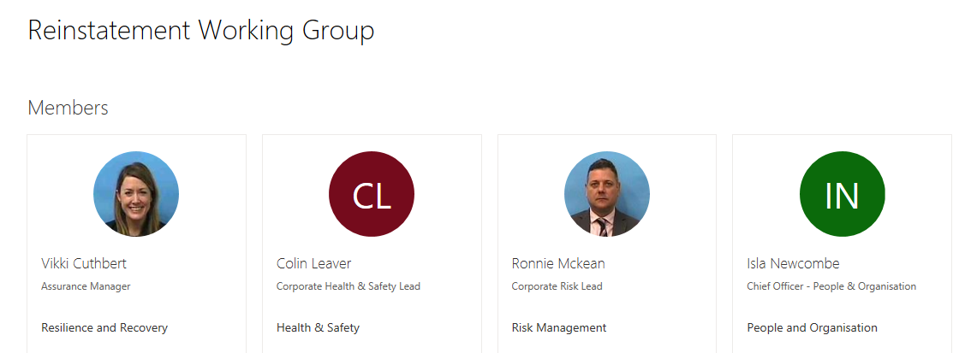
Reinstatement Working Group

Slide 8
What is the Process?
Reinstatement of Services
Reinstatement Working Group established
Initial Priorities
Reinstatement Gateway Questionnaire
Risk Assessments
Stakeholder engagement (including TU’s)
Weekly meetings
Report to IMT
Communication and training

Slide 9
What are the assumptions?
Reinstatement of Services
Health and Safety of Staff and customers takes priority.
The Guidance will change and evolve.
Priority will be given to critical and statutory functions.
There may be other new demands on our teams.
Building capacity will be significantly reduced with social distancing (customers and staff).
Supporting services may not have full capacity.
Working from home will be the starting point where possible.
During 2020 we will seek to limit the sites we have operational.
Desire to target spend at critical areas/ priorities and reduce elsewhere.

Slide 10
Timeline
1 July – 31 Mar. 2021
Now.
Transformed service delivery
Efficient estate
Adaptable and safe workplaces and practices
Balanced books
Limited service deliver/ buildings open
Prioritisation of organisation to COVID response
Home working – the new norm
Roadmap issued
Financial challenge

Slide 11
Action for leaders:
What Services did I deliver?
What am I delivering now?
What needs to be introduced, when and how?
How does my service meet with the Route map?
What will be the impact of social distancing be on my service?
What colleagues/ other services do I rely on and who else relies on them?
Where do I need some support and who can help with the process?

Slide 12
Your questions Ask the panel:
Vikki Cuthbert, Assurance Manager
Isla Newcombe, Chief Officer Organisational Development
Stephen Booth, Chief Officer Corporate Landlord
Martin Murchie, Duty Emergency Response Co-Ordinator

Slide 13
Build Back Better
Thank you for everything you are doing

